Slide 1
History of mechanical calculators
Pre-1800

Slide 2
Ancient history devices

Slide 3
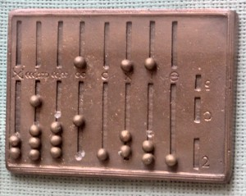
Abacus, 2400 BC
Babylonian and ancient romans used it for arithmetic computations by merchants, engineers.
Worked in base 10

Slide 4
Antikythera, ancient greeks, 150-100 BC
First analog computer
Complex clockwork having 37 gear wheels
Predict astronomical positions, follow moon’s movements, predict eclipses

Slide 5
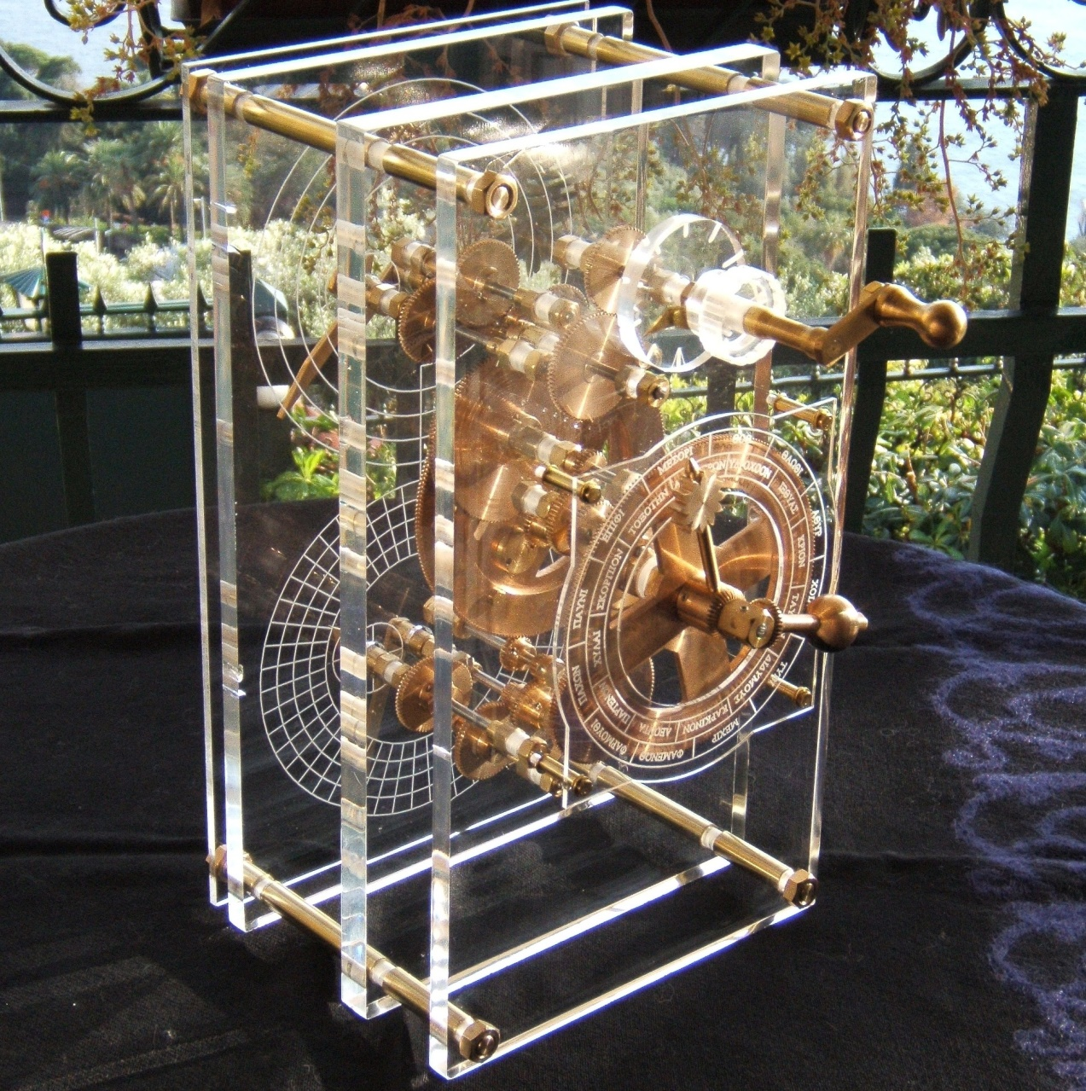
Antikythera (cont.)

Slide 6
Al-Jazari’s castle clock, 1206
the earliest programmable analog computer
Works with water
displayed the zodiac, the solar and lunar orbits
a crescent moon-shaped pointer traveling across a gateway causing automatic doors to open every hour
Had music and robotic figurines
The length of day and night could be re-programmed every day
Demo: https://www.youtube.com/watch?v=qz7soHvy-Pw

Slide 7
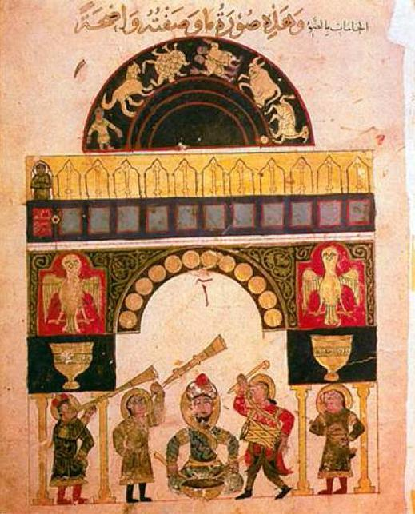
Al-Jazari’s castle clock

Slide 8
John Napier's calculating tables 1600
Tables that would help perform multiplications and divisions through additions, substractions and logarithms
explainations: https://en.wikipedia.org/wiki/Napier%27s_bones

Slide 9
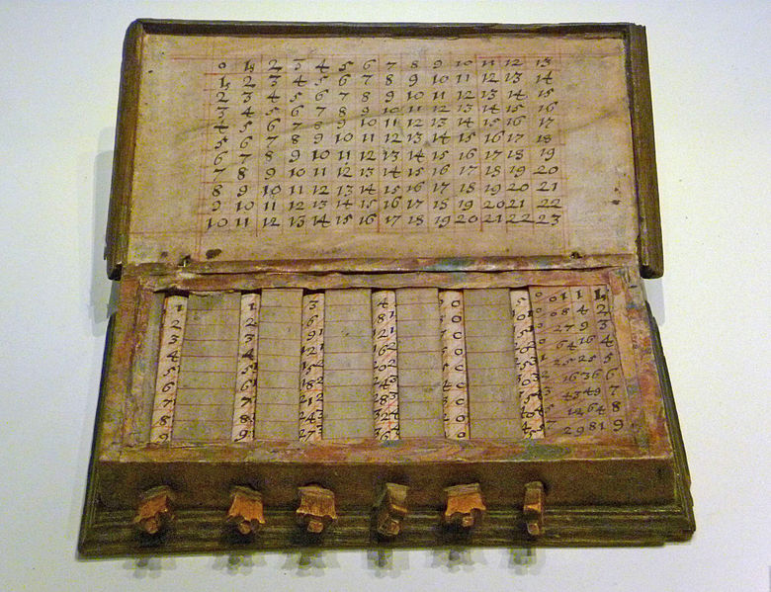
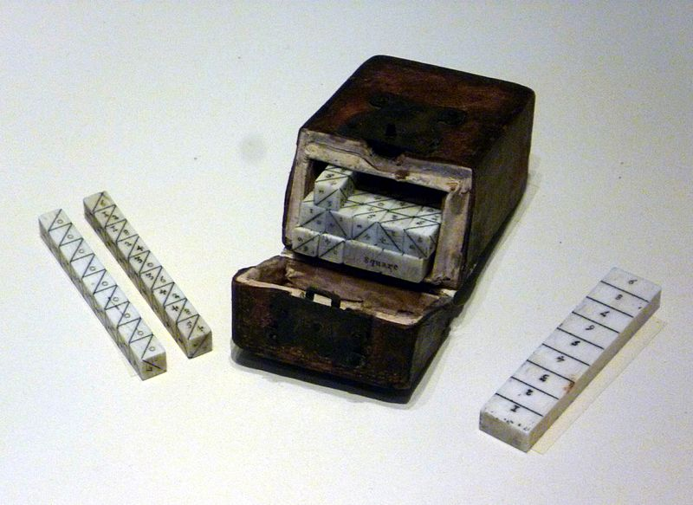
John Napier’s calculating tables (Napier bones)

Slide 10
Slide rule, 1620
real numbers can be represented as distance or intervals on a line
allows multiplication and division operations to be carried out significantly faster than was previously possible
can compute exponents, roots, logarithms and trigonometry

Slide 11
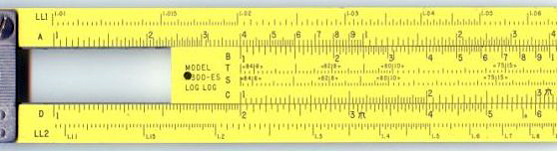
Slide rule, 1960

Slide 12
Schickard’s first digital mechanical calculator, 1623
Wilhelm Schickard built the first digital mechanical calculator
the machine was designed to assist in all the four basic functions of arithmetic (addition, subtraction, multiplication and division) on 2 multi-digit numbers)

Slide 13
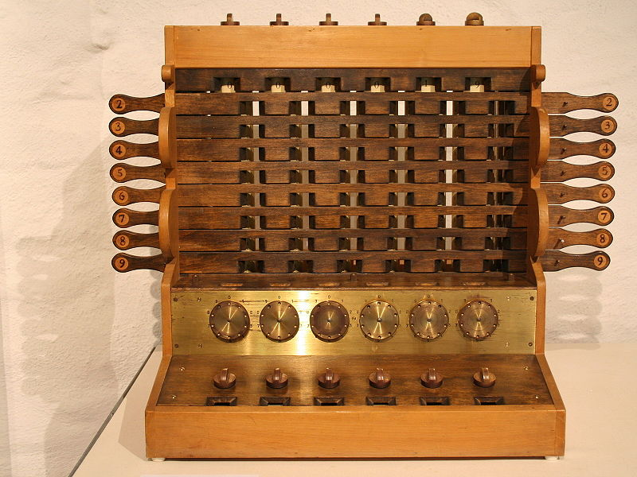
Schickard’s digital mechanical calculator

Slide 14
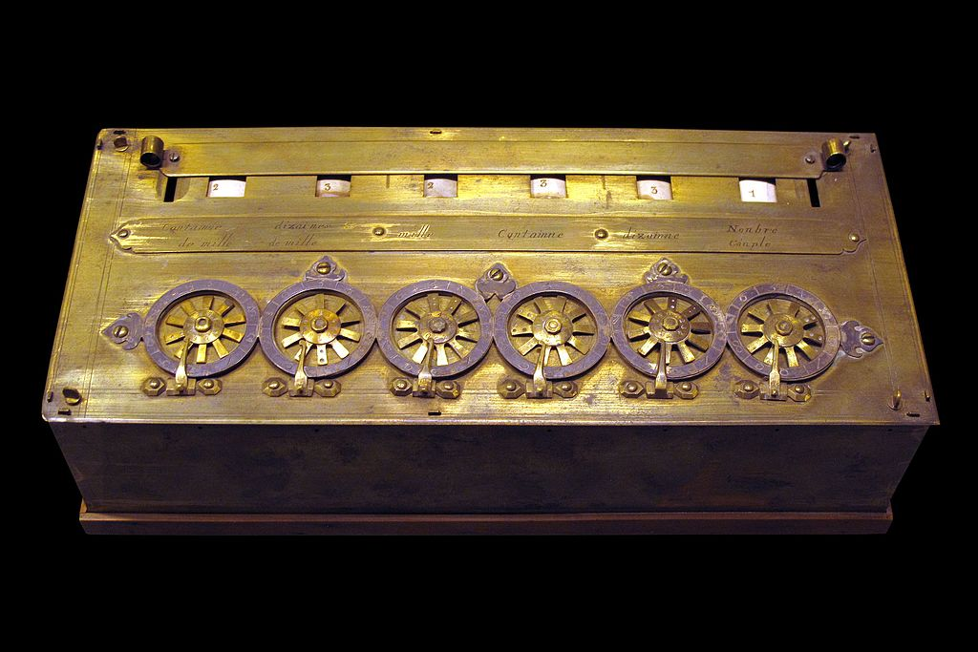
Blaise Pascal’s Pascaline, 1642

Slide 15
Blaise Pascal’s Pascaline (cont.)
Built by Pascal in order to help his father compute taxes
Started working to Pascaline in 1642 when he was 19 years old
Built 50 prototypes until he got to a final version; he then built 20 more
Represented negative numbers as complements in different bases
Operations supported:
Addition
Substraction
Multiplications and divisions through repeated additions+substractions

Slide 16
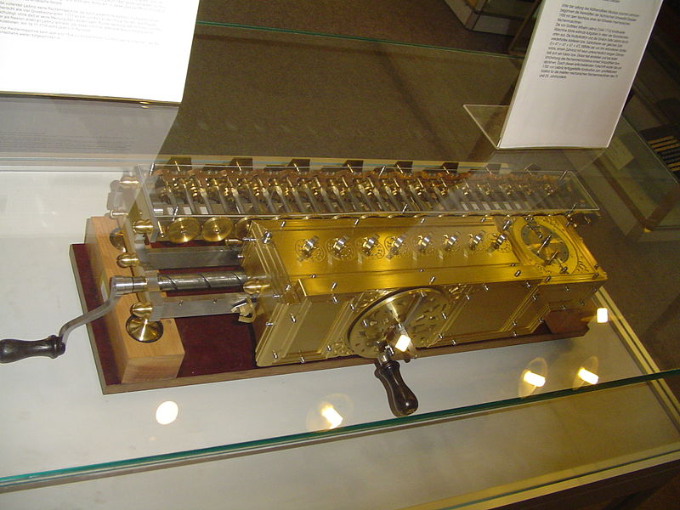
Leibniz’s Stepped Reckoner, 1672

Slide 17
Leibniz’s Stepped Reckoner (cont.)
Tried to add automatic multiplications to the Pascaline
Worked 40 years on its design, finally produced 2 working prototypes
Could perform :
add or subtract an 8-digit number to / from a 16-digit number
multiply two 8-digit numbers to get a 16-digit result
divide a 16-digit number by an 8-digit divisor
Multiplication and division procedure is detailed here:
https://en.wikipedia.org/wiki/Stepped_reckoner

Slide 18
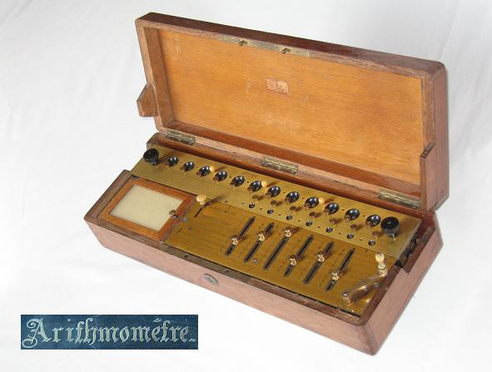
Thomas Arithmometer, 1820

Slide 19
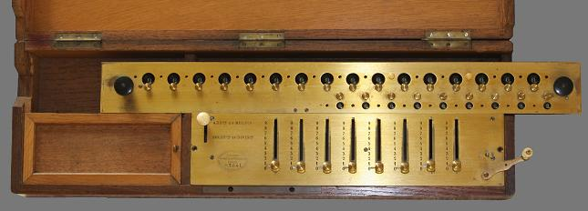
Thomas Arithmometer (cont.)
First digital mechanical calculator reliable enough to be used on a daily bases in an office (in France)
Could perform additions, substractions, multiplications and divisions
various models had capacities of 10, 12, 16 and 20 digits
A 12-digit arithmometer sold for 300 francs in 1853, which was 30 times the price of a table of logarithms book

Slide 20
1800 : first general purpose mechanical calculators
Charles Babbage’s Difference engine and analytical engine

Slide 21
Post-1800 mechanical calculators

Slide 22
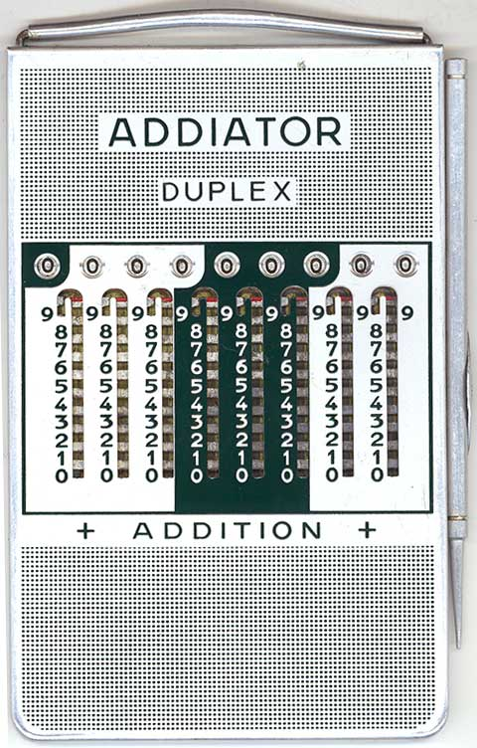
Addiator, Berlin, 1920-1982

Slide 23
Addiator (cont.)
made by Addiator Gesellschaft, Berlin
Could perform naturally additions and substractions
There were procedures for multiplications and divisions through severall additions and substractions
Mechanical calculator

Slide 24
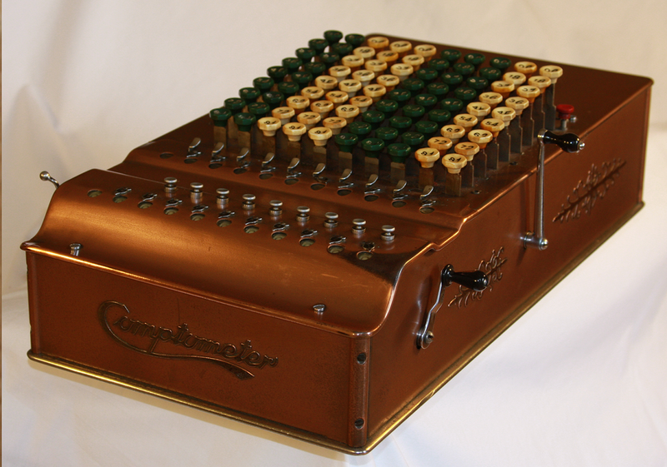
Comptometer, US, 1887-1970

Slide 25
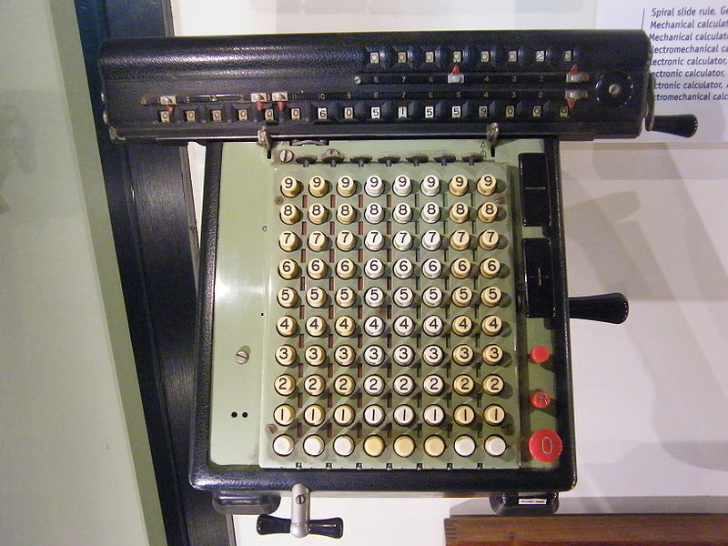
Monroe machine, US, 1912-1970

Slide 26
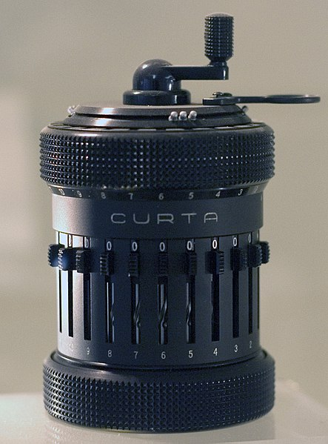
Curta, Austria, 1930-1970

Slide 27
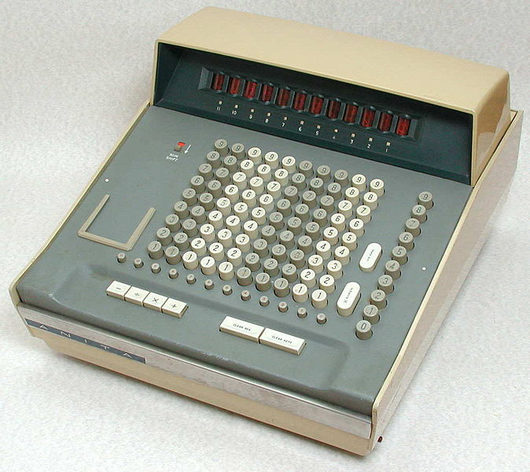
ANITA MarkVIII, UK, 1961
First all electronic desktop calculator

